Slide 1
Math II
Mr. Bryant

Slide 2
Help!
Math 2 Student Support How do I get to those Math 2 MVP Homework Help Videos!?!? Go to wakeid.wcpss.net Log in with your WCPSS google account Choose the Orange “Canvas” Button Click on “Courses” on the left Choose the course called “NC Math 2 Student Support Site” Choose whichever Module we are currently working on Choose whichever Module’s video you need help with!

Slide 3
Outside of school help
My office hours are Tuesday and Thursday 2:30-3:30 in room 604 or 606.
I will also be available select other days. Students should ask me in advance concerning these days.
I am always available before school starting at either 6:30 or 6:45 depending on day.

Slide 4
Homework/Notes
Homework will almost always be out of their workbooks and I will attempt to consistently tell you what it is on the blog portion of my website: www.mradambryant.weebly.com
Notes
Most days we do not take formal notes and will instead be working in the workbook. Many days I attempt to summarize our learning and expect students to write those down in a notebook to keep up with all the learned information. They should also keep them out during lessons to take notes.

Slide 5
Contact Info
Email: abryant@wcpss.net
Website: mradambryant.weebly.com
School Phone: 919-570-5600

Slide 6
Materials
Grading
Homework will be graded by completion daily.
Honors:

Slide 7
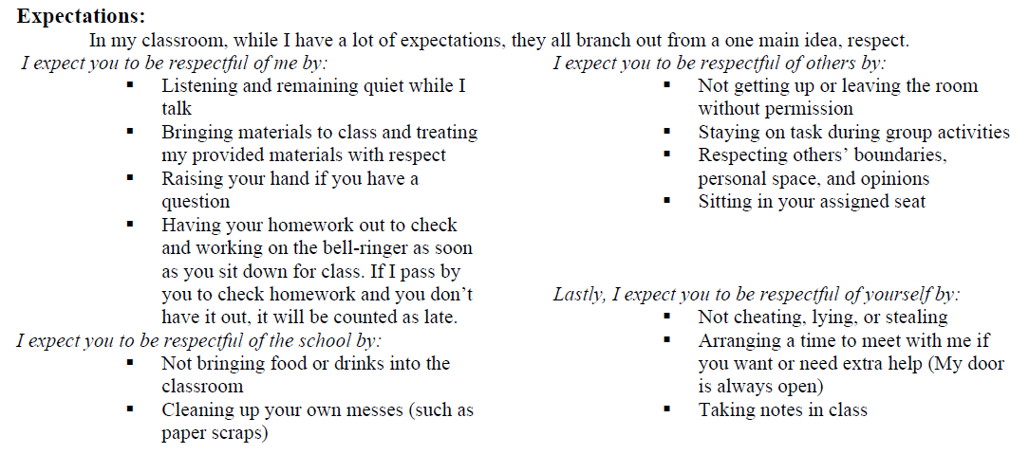
Rules

