Slide 1
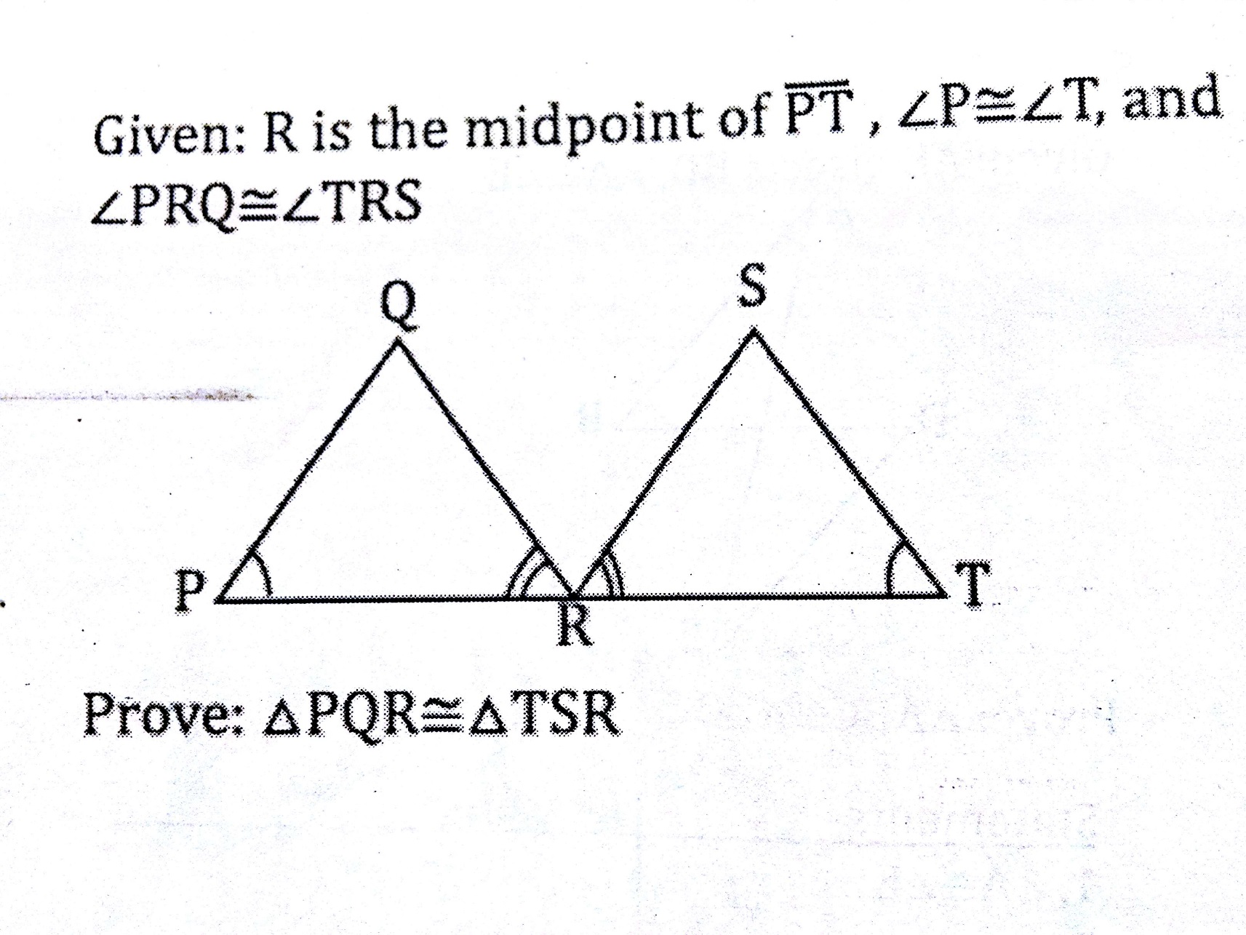
Statements
__________
$\text{<}\text{PRQ}≅<TRS$
R is midpoint of $\overline{PT}$
____________
$∆PQR≅∆TSR$
Justifications
Given
________
Given
Def of midpoint
_____ $≅$postulate

Slide 2
Homework
Part 1
1. 30 2. 100 3. 140 4. 35 5. 60, 60, 60, 120, 120
6. 40 7. 62 8. 65 9. 116 10. a: 30 b: 60
Part 2
1. 5 2. 20 3. 15 14. 38 15. 18
16. 14 17. 3 18. 5 19. AD= 12, BC=16

Slide 3
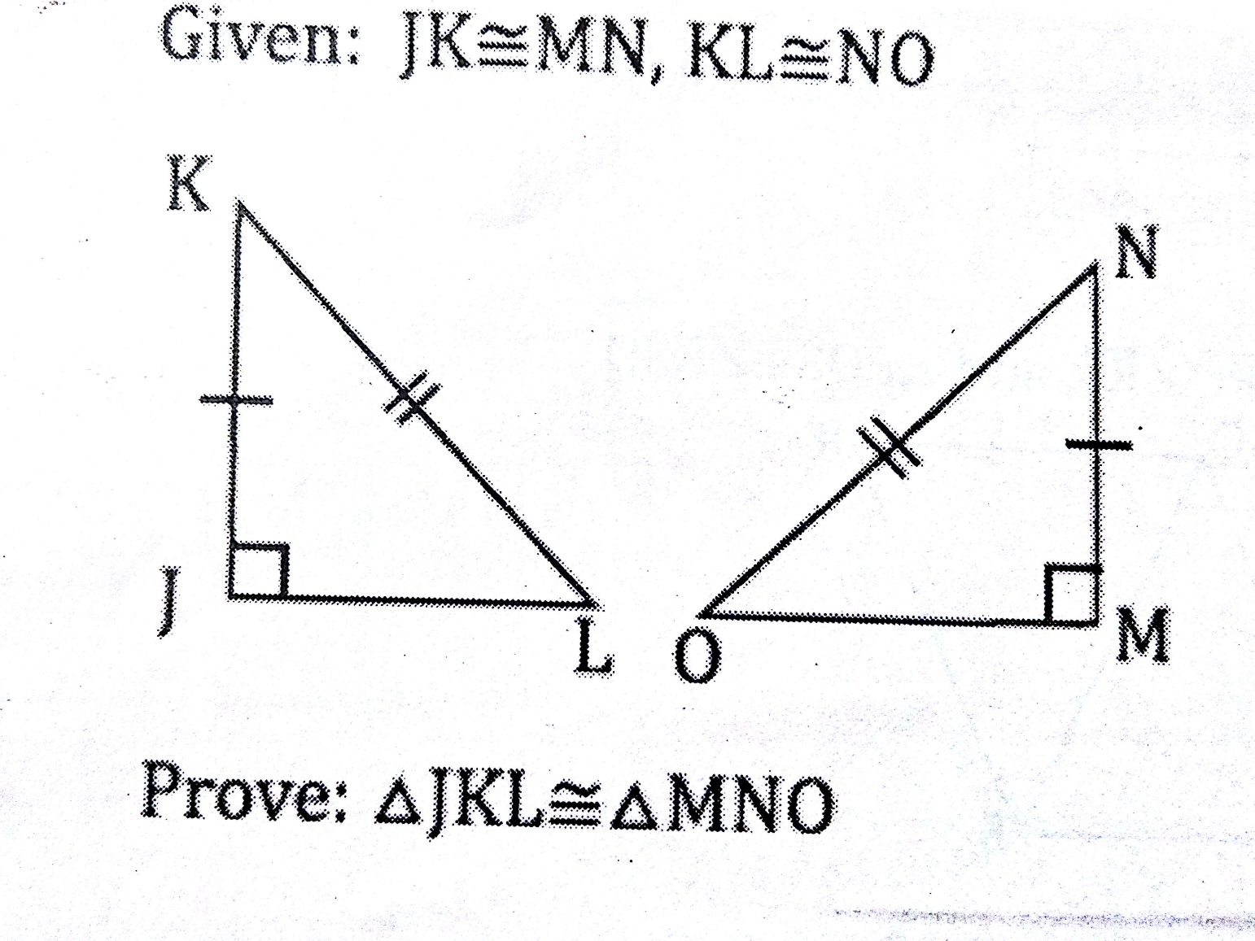
Statements
___________
___________
$∆JKL and ∆MNO$ $are right triangles$
$∆JKL≅∆MNO$
Justifications
Given
________
_________
_____ $≅$postulate

Slide 4
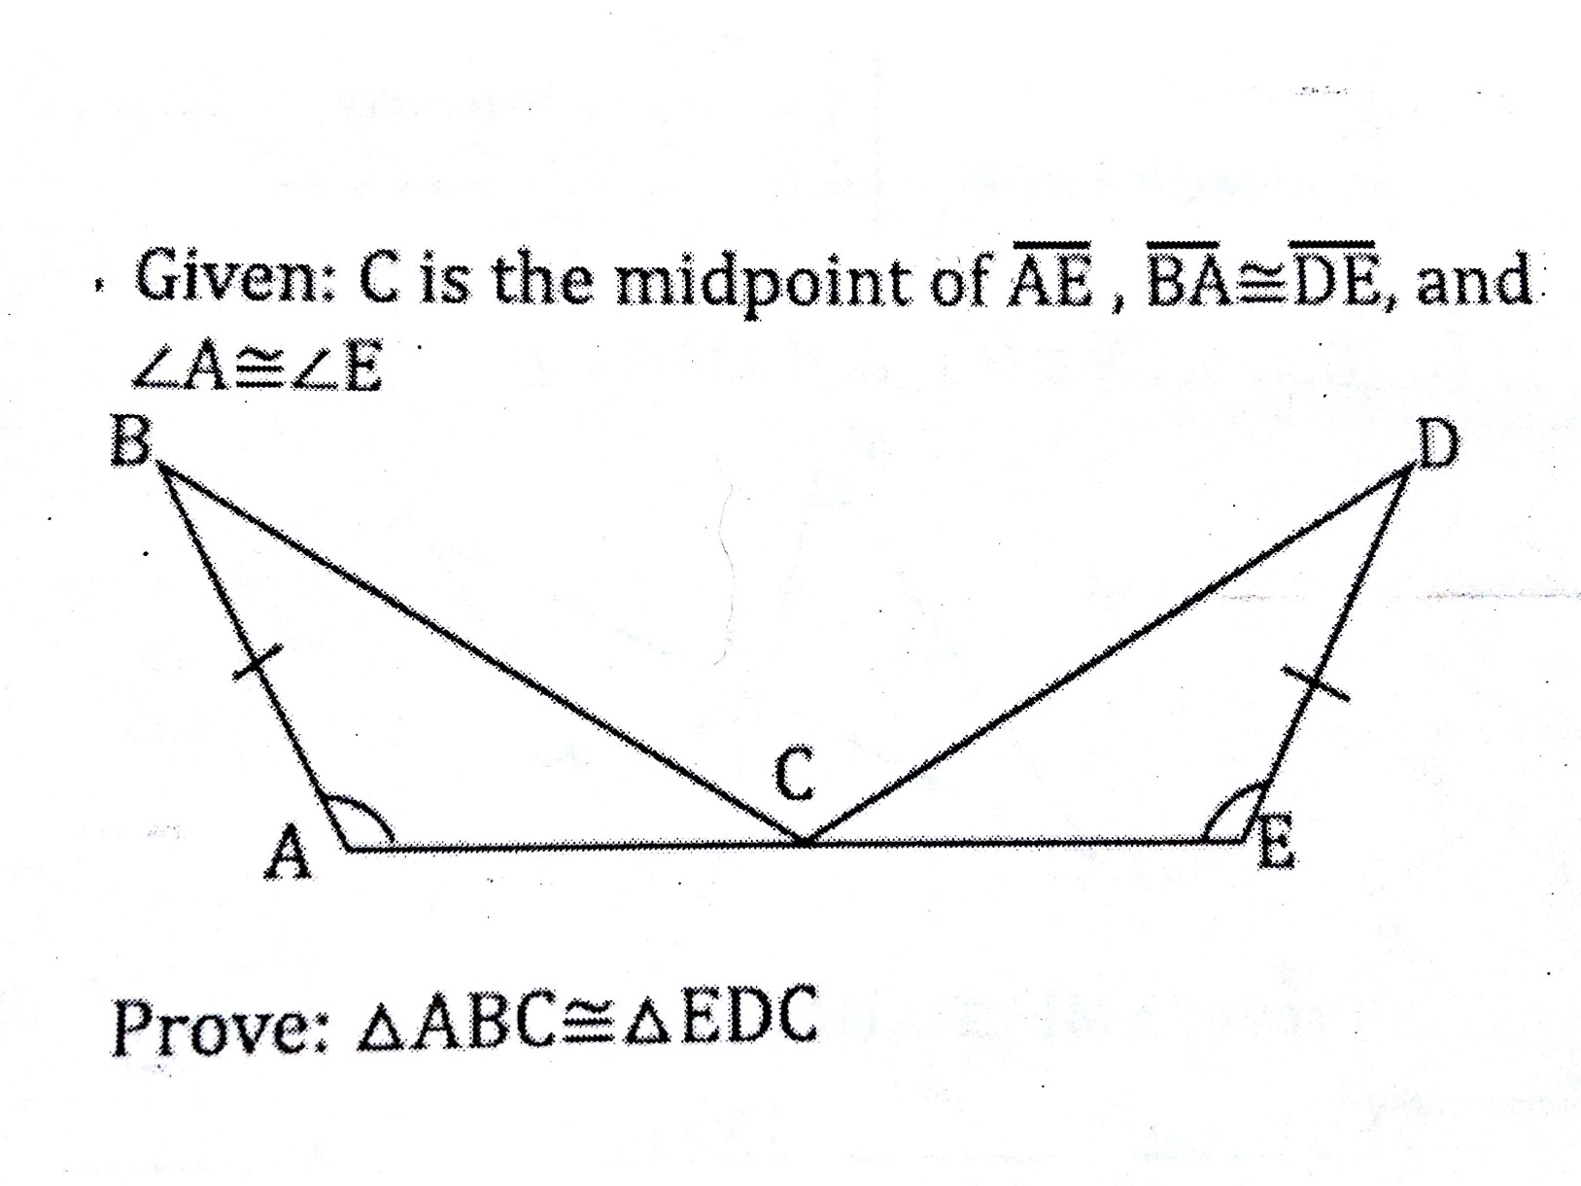
Statements
___________
___________
____________
$\overline{AC}≅\overline{CE}$
$∆ABC≅∆EDC$
Justifications
Given
________
_________
_________
_____ $≅$postulate

Slide 5
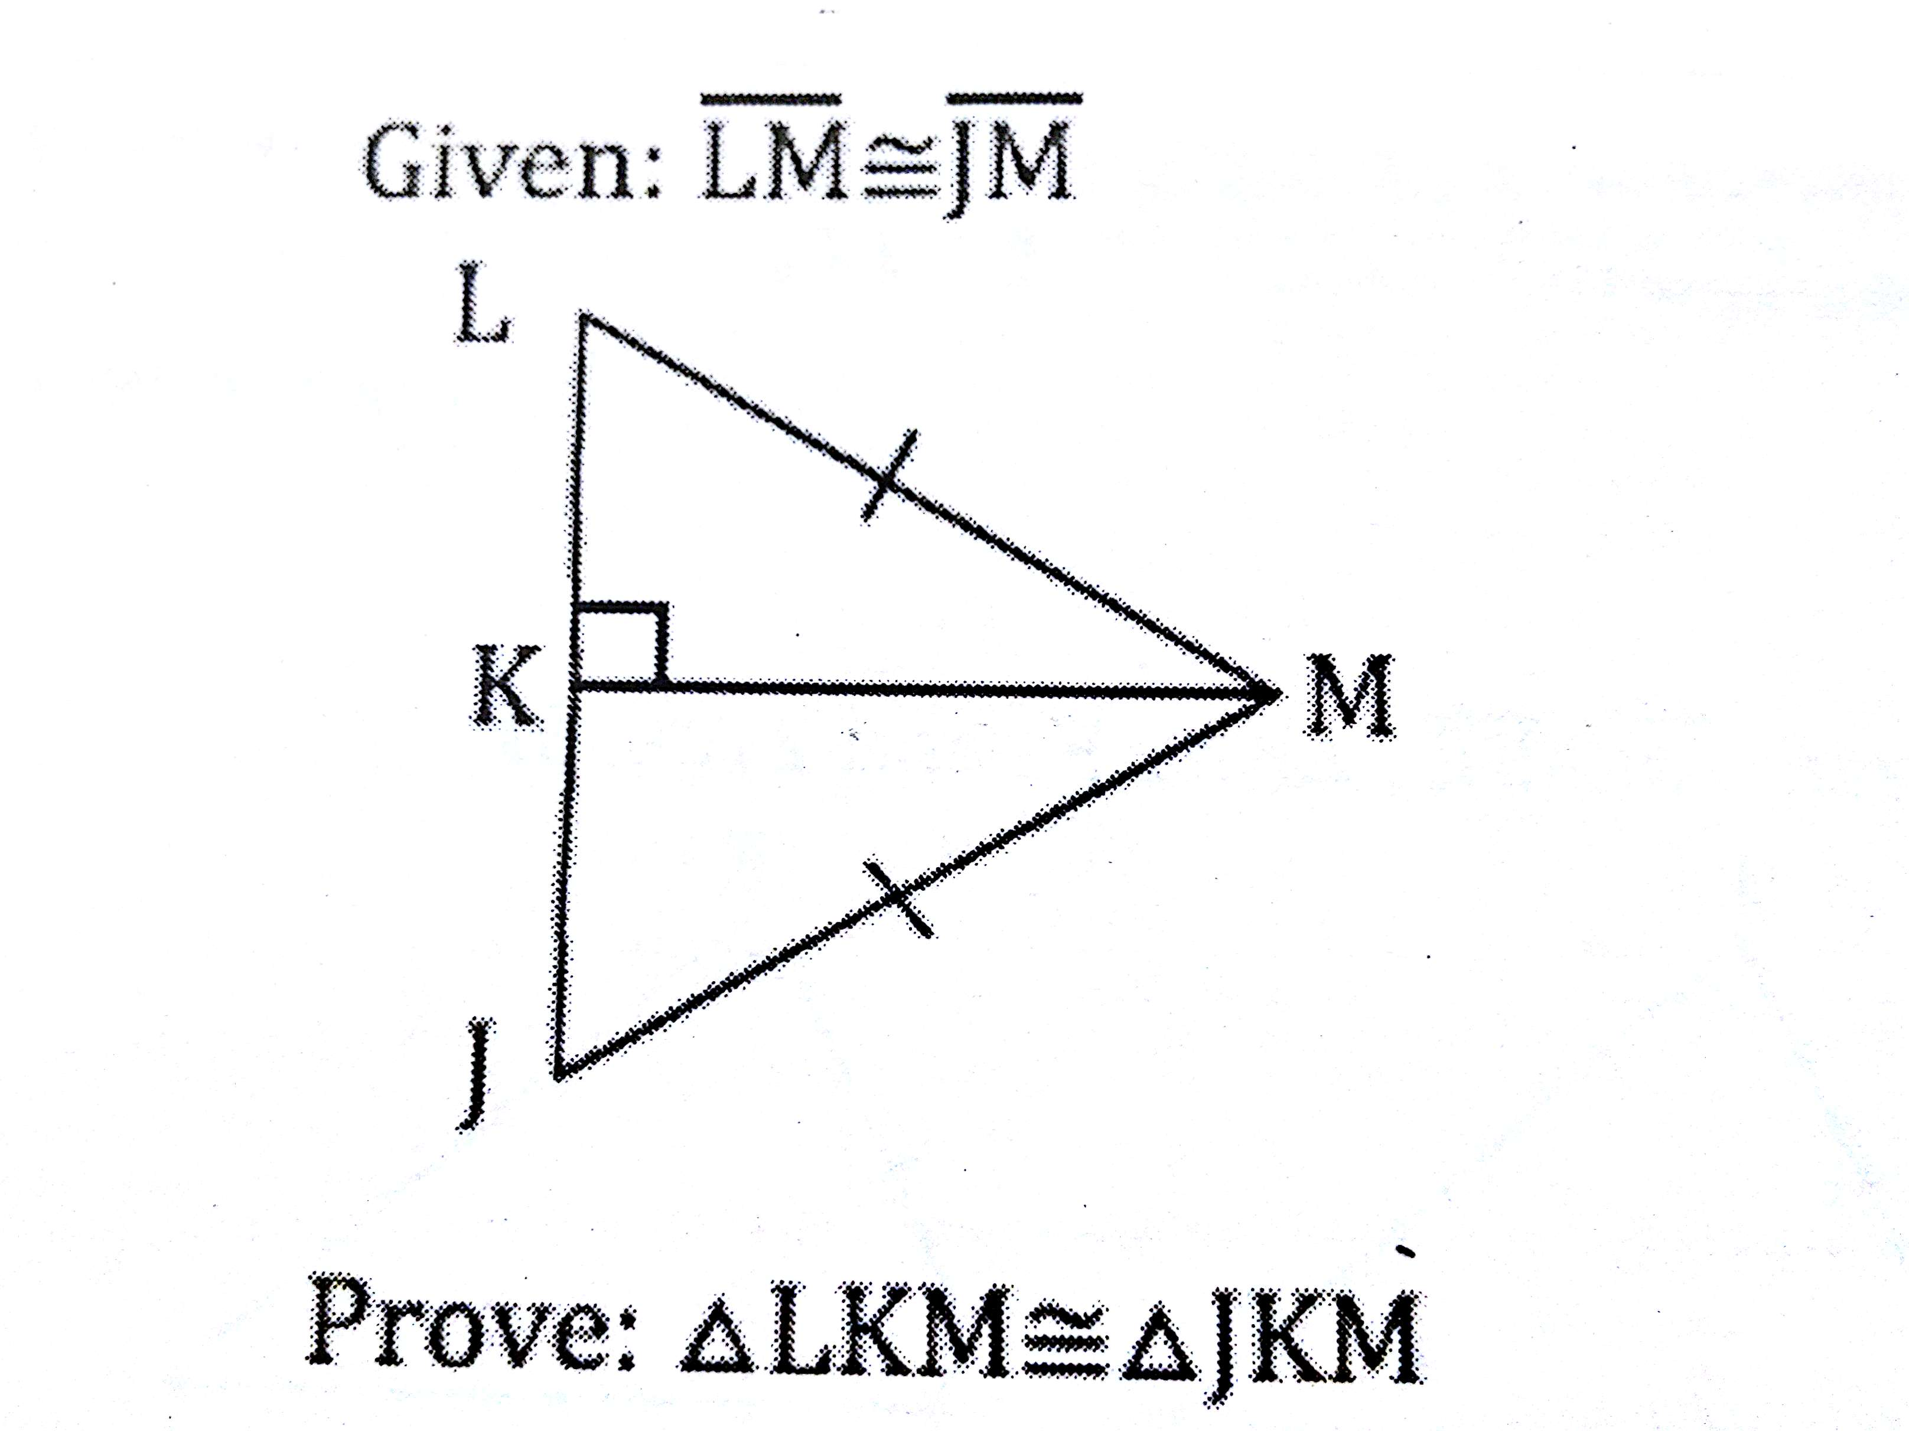
Statements
__________
<LKM is a right angle
<JKM is a right angle
$∆LKM$ and $∆JKM$ are right triangles
___________
$∆LKM≅∆JKM$
Justifications
Given
Given
Linear Pair Postulate
,
Reflexive property of $≅$
_____ $≅$postulate

