Slide 1
U3 Radical and Exponential Functions

Slide 2
U3 D1

Slide 3
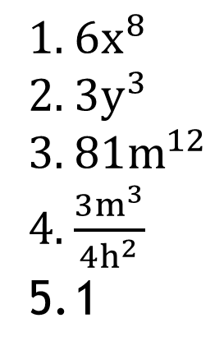
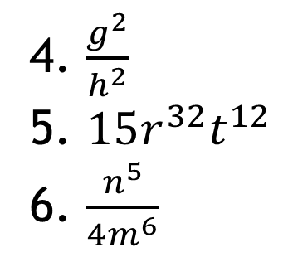
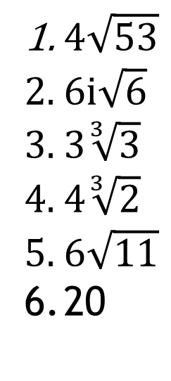
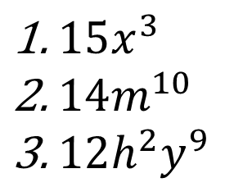
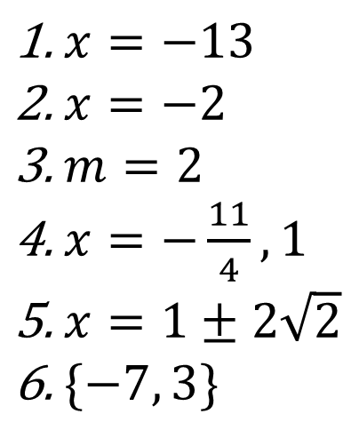
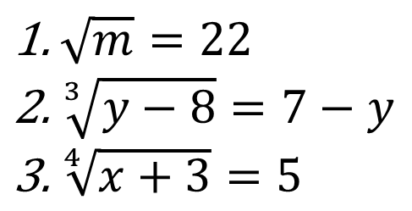
Warm Up: Check Homework and Discuss
$4\sqrt{53}$
$6i\sqrt{6}$
$3\sqrt[3]{3}$
$4\sqrt[3]{2}$
$6\sqrt{11}$
20
$6x^{8}$
$3y^{3}$
$81m^{12}$
$\frac{3m^{3}}{4h^{2}}$
1
$\sqrt{m}=22$
$\sqrt[3]{y−8}=7−y$
$\sqrt[4]{x+3}=5$
$x=−13$
$x=−2$
$m=2$
$x=−\frac{11}{4}, 1$
$x=1±2\sqrt{2}$
$\{−7, 3\}$
$15x^{3}$
$14m^{10}$
$12h^{2}y^{9}$
4. $\frac{g^{2}}{h^{2}}$
5. $15r^{32}t^{12}$
6. $\frac{n^{5}}{4m^{6}}$

Slide 4
Review Test

Slide 5

Monomial Rules
1. ${\left(x^{3}x^{8}\right)}^{4}$ 2. $\frac{y^{3}x^{2}}{yx^{3}}$ 3. $\frac{3x^{4}6y}{9xy^{3}}$

Slide 6

Adding and Subtracting Polynomials
1. $\left(5x^{2}+3x−1\right)+(2x^{2}−4x−7)$
2. $\left(8x^{4}−16x\right)−(2x^{2}−x+3x^{4}−1)$
3. $\left(2x^{3}−14x+7\right)−(5x−2x^{3}+8)$

Slide 7

Multiplying Polynomials
1. $3x(8x−2)$ 2. $(2x+1)(x−3)$
3. $(4x−7)(x^{2}+2x−3)$

Slide 8
U2 D2

Slide 9
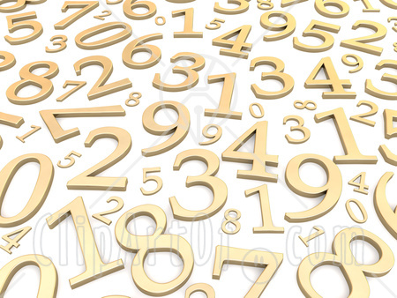
Warm-up
Simplify:
$\left(2mn^{2}\right){\left(2m^{7}n^{3}\right)}^{4}$
$\frac{{\left(3y^{2}z\right)}^{−1}}{2yz^{4}}$
${\left({\left( \frac{2\left(a^{4}b\right)}{c^{2}b^{5}}\right)}^{0}\right)}^{4}$
$\frac{g^{−3}h^{6}}{{\left(gh\right)}^{−2}\left(4h\right)}$

Slide 10

Warm Up
1. $\frac{6x^{4}y^{3}}{{(3x)\left(x^{3}y^{8}\right)}^{−2}}$ 3. $(2x+1)(x+y+1$)
2. $\left(2x^{2}−7x+11\right)−(8x+14−x^{2})$

Slide 11

Homework
1. $\frac{1}{x^{20}}$ 2. $2n^{8}$ 3. $8x^{8}y^{6}$ 4. $\frac{x^{4}y^{3}}{4}$ 5. $\frac{x}{4}$ 6. $7b^{5}+b$
7. $−3p^{3}+7p^{2}−3p$ 8. $a^{2}−3$ 9. $12a^{5}+14a^{4}−10a^{3}−14a$
10. $2b^{4}+15b^{3}−3$ 11. $12v^{2}+18v$ 12. $12n^{2}+14n+2$
13. $7k^{3}−17k^{2}+55k−21$ 14. $−2n^{3}−11n^{2}+14n−4$
15. $14r^{3}−40r^{2}+12r+24$

Slide 12
Quiz

Slide 13
For Homework
View: http://tinyurl.com/hm7vwak

Slide 14
U3 D3

Slide 15
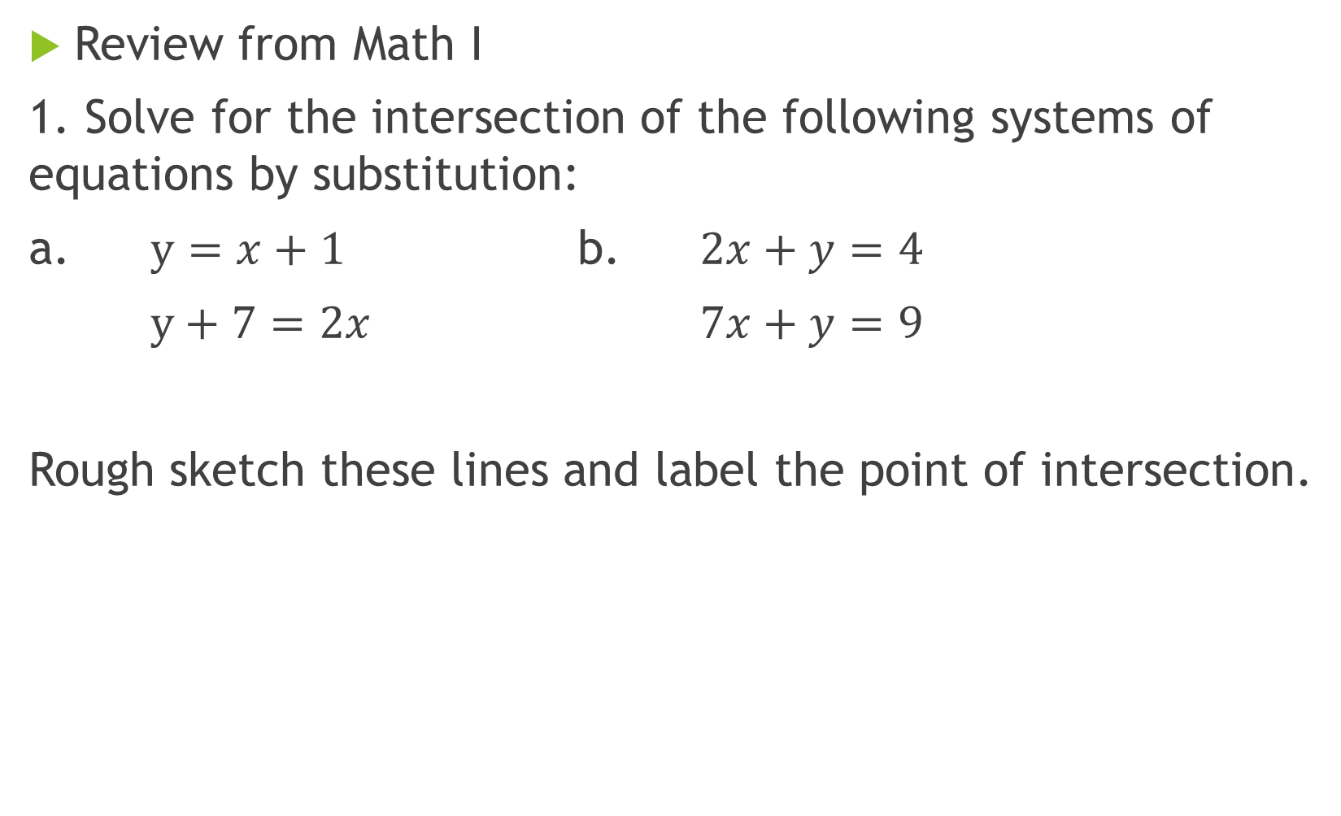
Warm Up
Review from Math I
1. Solve for the intersection of the following systems of equations by substitution:
a. $y=x+1$ b. $2x+y=4$
$y+7=2x$ $7x+y=9$
Rough sketch these lines and label the point of intersection.
{
{

Slide 16

Warm Up
Graph the following and state the number of intersections, if any.
a. $y=x^{2}+1$ b. $y=x^{2}+4x+4$
$y=2x+7$ $y=7x−9$
{
{

Slide 17
Review Quiz

Slide 18
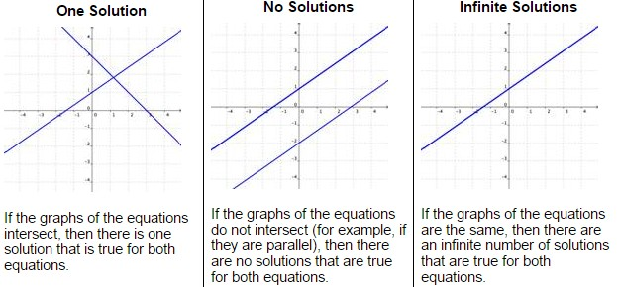
Linear systems of equations
Notes:
http://www.montereyinstitute.org/courses/Algebra1/COURSE_TEXT_RESOURCE/U10_L2_T2_text_container.html

Slide 19
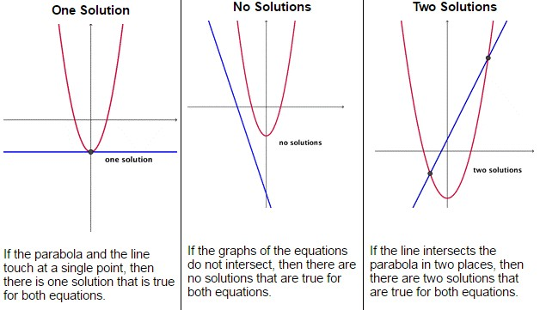
Nonlinear systems: Parabola and Line
Notes:
http://www.montereyinstitute.org/courses/Algebra1/COURSE_TEXT_RESOURCE/U10_L2_T2_text_container.html

Slide 20

Practice Solving
1. $y=x^{2}−2$ 2. $y=x^{2}+2x+3$
$y=2x+1$ $y=4x+2$
3. $y=x^{2}−2x−1$
$y=3x−10$
{
{
{

Slide 21
A rocket is launched from the ground and follows a parabolic path represented by the equation y = -x² + 10x. At the same time, a flare is launched from a height of 10 feet and follows a straight path represented by the equation y = -x + 10. When and at what height does the flare and the rocket meet?

Slide 22
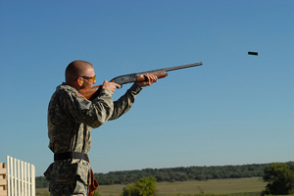
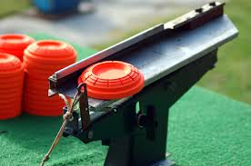
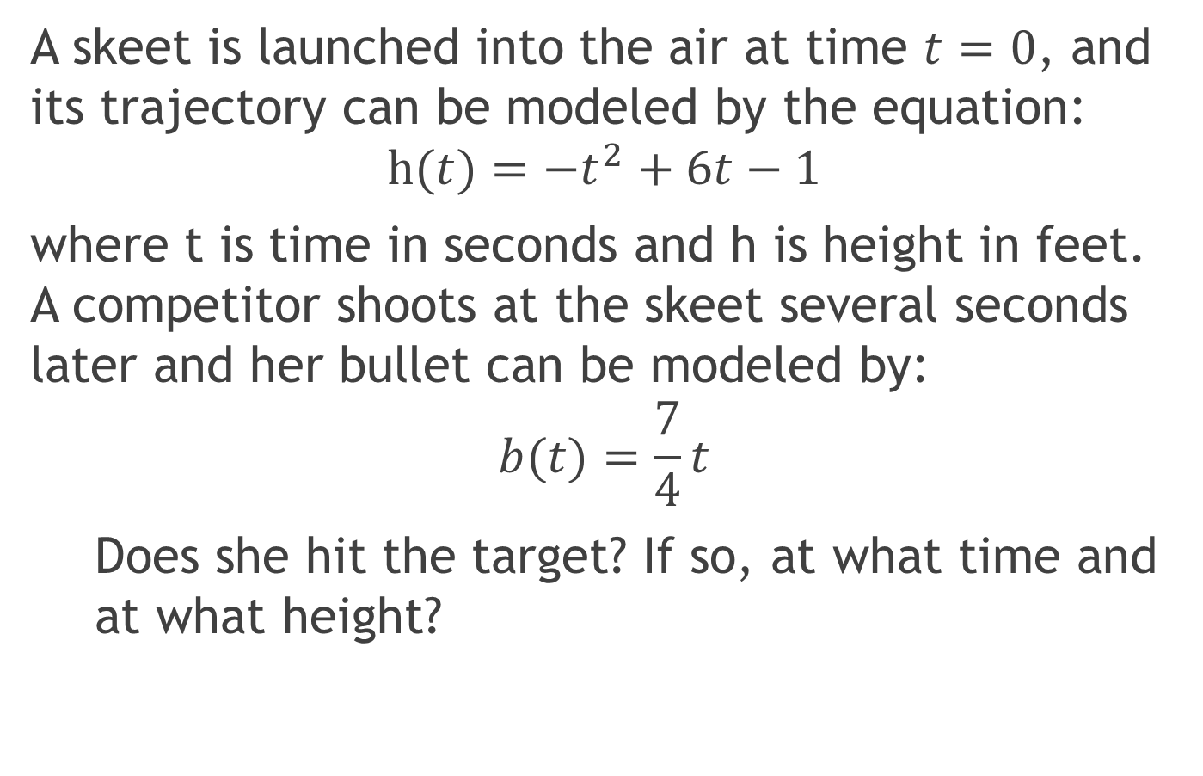
Practice Solving: Word problem
A skeet is launched into the air at time $t=0$, and its trajectory can be modeled by the equation:
$$h(t)=−t^{2}+6t−1$$
where t is time in seconds and h is height in feet. A competitor shoots at the skeet several seconds later and her bullet can be modeled by:
$$b(t)=\frac{7}{4}t$$
Does she hit the target? If so, at what time and at what height?
Notes:
https://classes.lt.unt.edu/Fall_2014/LTEC_3260_020/ccl0083/assign1/index.html

Slide 23
U3 D5

Slide 24

Warm Up
Solve for intersections (if any exist)
1. y = x² + 4x + 3 2. y = -x² + 2x + 4
y = 2x + 6 y – 4 = 2x
How many solutions? (Graph)
3. y = x² + 4x + 3 4. $x^{2}+y^{2}=25$
y = 2x + 6 $x−y=5$

Slide 25
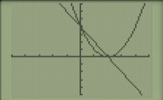
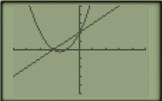
Homework
1. 2.
3. (2,5) and (4,9) 4. (0,4) and (3, -7)
5a. Price: $5 Profit: $1000 5b. (1, 360) and (10, 0)

Slide 26
System of Line and Circle

Slide 27
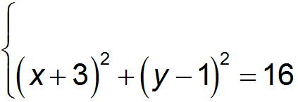

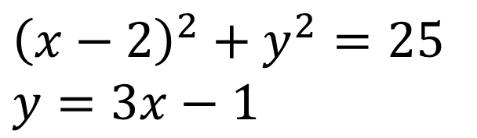
System of Line and Circle
1. 2. $y=x+8$
3.
$${\left(x−2\right)}^{2}+y^{2}=25$$
$$y=3x−1$$

Slide 28
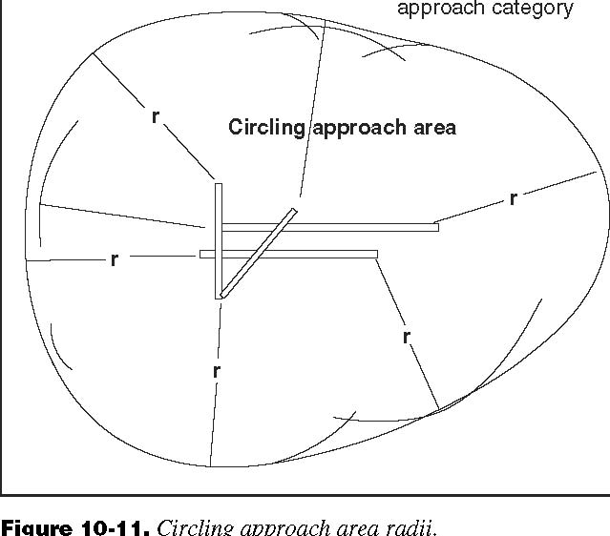
System of Line and Circle
An airplane making its final approach to an airport can be (very) roughly modeled by (x - 2)² + (y + 3)² = 4. Another airplane is taking off and follows flight path with equation 2x + 2y = -1. Assuming the heights of the aircraft are the same, will the airplanes collide? If so, at what position will the planes be?
Notes:
https://www.americanflyers.net/aviationlibrary/instrument_flying_handbook/chapter_10.htm

Slide 29
U3 D5
See other powerpoint (U3 D5 notes: solving radical equations)

Slide 30
Warm Up

Slide 31
Homework
1. (5, 5) and (-5, -5) 2. (5, 1) and (-5, -1)
3. D 4. C 5. (0, 3) and (-3, 0)

Slide 32

Solving radical equations
1. $\sqrt{x}=9$ 2. $x^{\frac{1}{2}}=16$
3. $\sqrt[3]{x+1}=3$ 4. ${\left(x+1\right)}^{\frac{1}{3}}=2$
5.${\left(2x+3\right)}^{\frac{2}{3}}=9$ 6. ${\left(3x−7\right)}^{\frac{5}{2}}=−32$

Slide 33

Solving Radical Equations:
CHECK YOUR SOLUTION(S)!!
1. $\sqrt{x+2}−2=x$ 2. ${\left(3x−2\right)}^{\frac{1}{2}}=−5$
3. ${\left(2x+7\right)}^{\frac{1}{2}}−x=2$ 4. $3x^{\frac{4}{3}}+5=53$

Slide 34
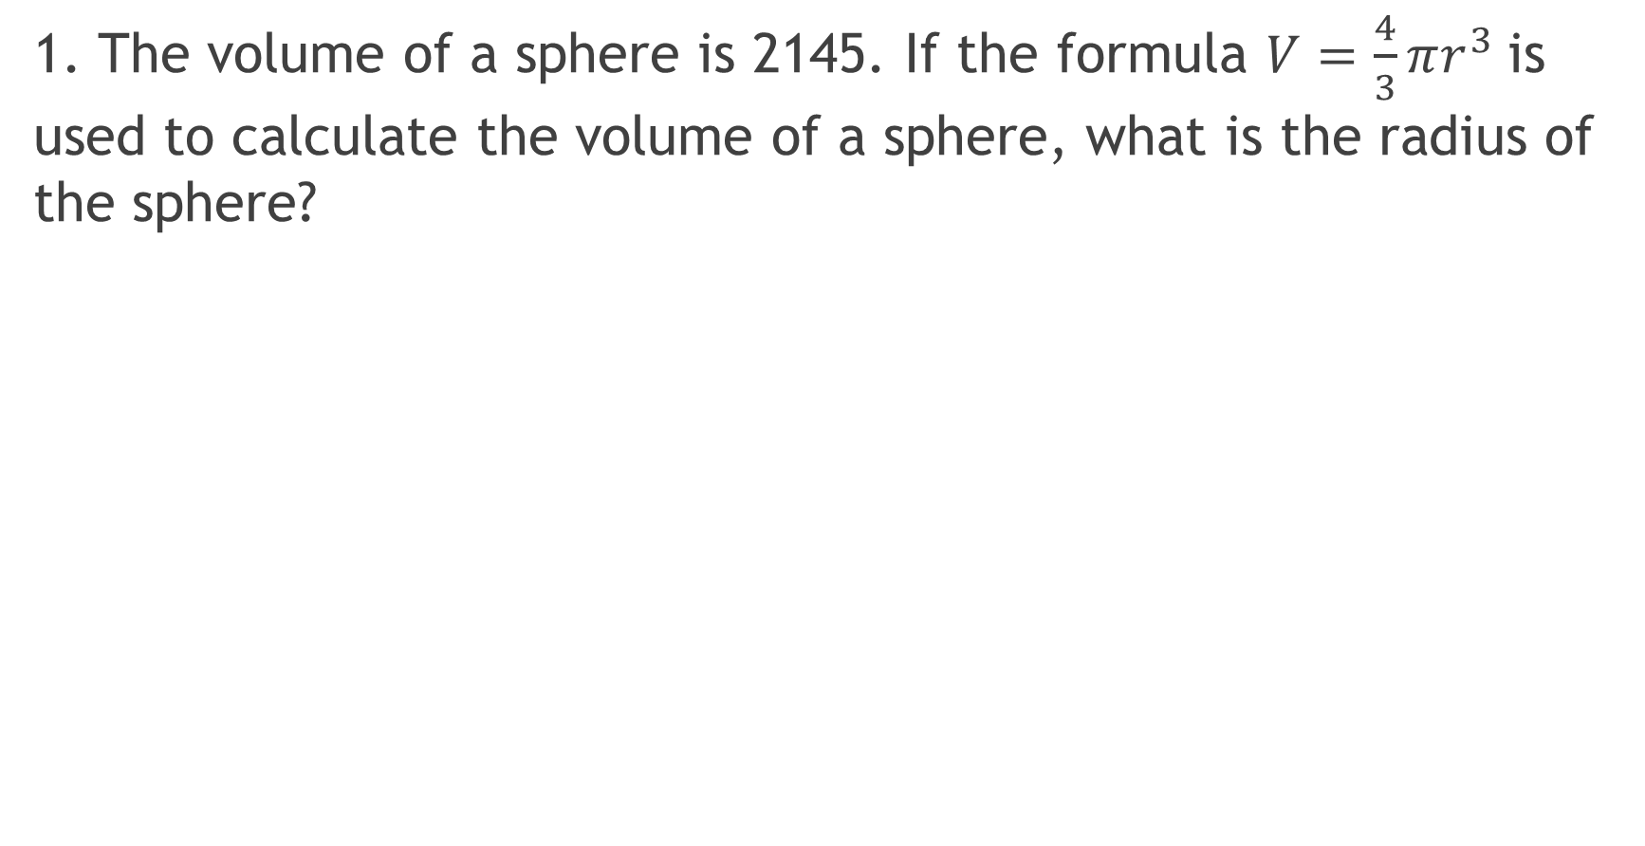
Applications of radical equations
1. The volume of a sphere is 2145. If the formula $V=\frac{4}{3}πr^{3}$is used to calculate the volume of a sphere, what is the radius of the sphere?

Slide 35
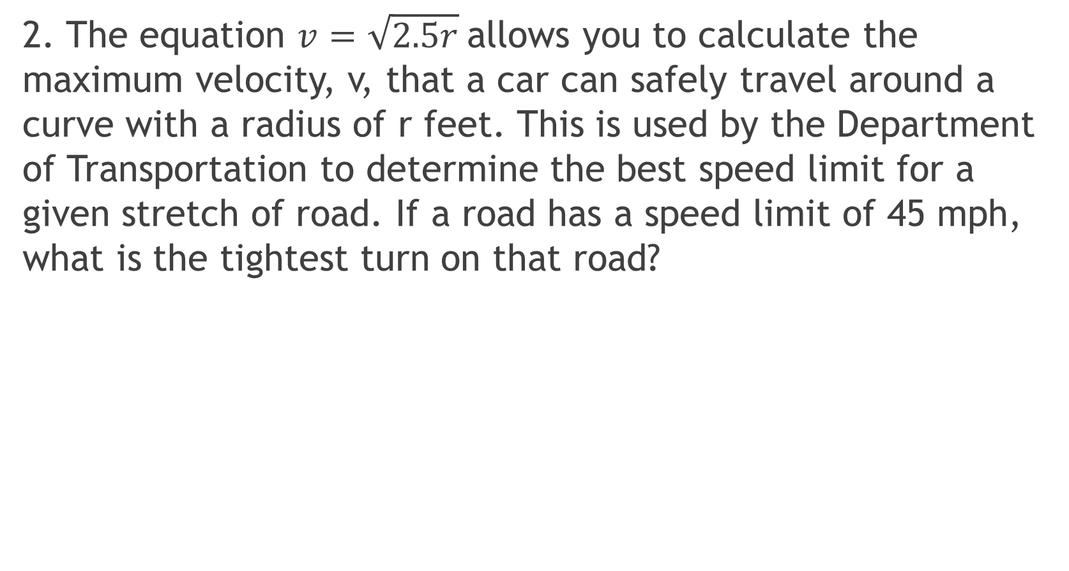
Applications of radical equations
2. The equation $v=\sqrt{2.5r}$allows you to calculate the maximum velocity, v, that a car can safely travel around a curve with a radius of r feet. This is used by the Department of Transportation to determine the best speed limit for a given stretch of road. If a road has a speed limit of 45 mph, what is the tightest turn on that road?

Slide 36
U3 D5

Slide 37

Warm Up
1. $\sqrt{x}+1=5$ 2. $x^{\frac{5}{3}}=−23$
3. $x−5=\sqrt{x+1}$ 4. $−x+\sqrt{6x+19}=2$
5. ${3x}^{2}+{3y}^{2}=27$ 6. $y=2x^{2}−3x+4$
$y=−x−3$ $y=−x+16$

Slide 38
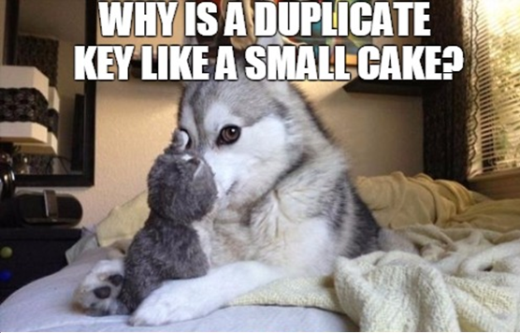


Here is Bad Joke Dog with your homework answers:

Slide 39
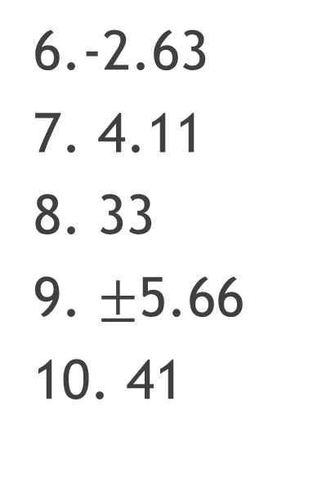
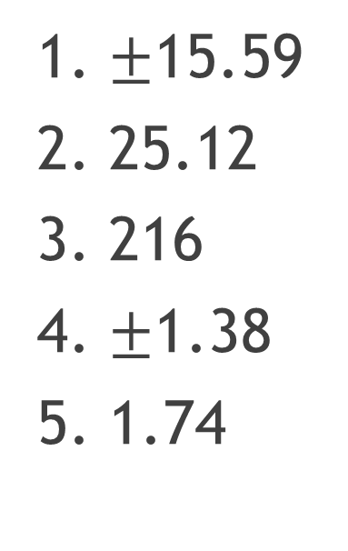
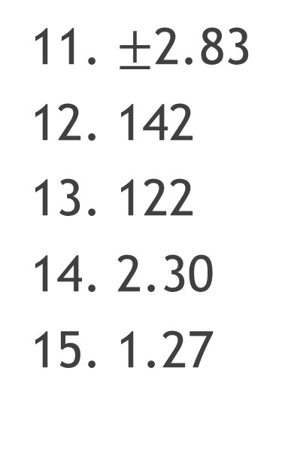
Homework
1. $±$15.59
2. 25.12
3. 216
4. $±$1.38
5. 1.74
6.-2.63
7. 4.11
8. 33
9. $±$5.66
10. 41
11. $±$2.83
12. 142
13. 122
14. 2.30
15. 1.27

