Slide 2
Let’s get started.
Click to the next slide ASAP!
Welcome to a Talking Day.

Slide 3
Just an FYI
I fully expect the roles to fulfill their obligations this time. That means you need to read carefully what is expected of each role.
Read all of the instructions aloud!

Slide 4
Step 1: Choose Roles
Role | Duties | Benefits
Mediator | Lead the discussion Call on participants Ask leading questions Talk to the teacher | Automatic 10/10
Timer | Keep track of time Keep participants on task | 2 Bonus Points
Recorder | Record group’s responses Submit group responses for grade Ask clarifying questions to the group | Automatic 10/10
Everyone Else | Talk Take notes Contribute to the group grade | Standard Grading (see next slide)
Board Recorder | Write down group responses on white board for all to see | Automatic 10/10
Click to the next slide as soon as roles are decided.

Slide 5
Step 2: Understand Grading
What to do…. | How you’re graded…
Talking | Each participant is responsible for contributing to the group’s objective(s). Each time a participant contributes to the group’s objective(s) in a *meaningful way, he or she will receive one point. Participants may receive up to 4 total talking points. Do not expect every time you talk to earn you a point.
Note Taking | Each participant is responsible for taking notes throughout the discussion. Notes will be handed in at the end of class. Participants receive two points for every half page of notes. Participants may receive up to 4 note points.
Group Grade | The group is responsible for finishing and submitting the teacher generated task(s) in the allotted time. The task will be graded out of 3 points. Each participant will receive the same grade on the task.
Click to the next slide as soon as everyone understand grading concepts.
Remember, the Mediator and the Recorder get an automatic 10/10 for their grade while the Timer gets two bonus points added to his or her grade.

Slide 6
Tomorrow’s Test Mediator should read this slide aloud. Move onto the next slide when done.
Want another reason to take good notes? You will be tested on this exact material tomorrow. These are very similar to the topics and problems on the test

Slide 7
Step 3: Task 1
The class has 8 minutes to come up with a WELL ORGANIZED overview of the topics in this unit and the purpose of each. I fully expect these to be organized on the board in a logical manner. A response that gets the group of track will not be counted.
Click to the next slide as soon as the group understands the task.

Slide 8
Step 4: Record
Type here if necessary.

Slide 9
Step 5: Task 2
The class has 12 minutes to simplify the following:
$$\left(3x^{3}y^{4}\right)\left(4x^{2}y^{5}\right)$$
$${\left(2a^{4}b^{2}\right)}^{3}$$
$$\frac{15c^{2}d^{5}}{12c^{4}d^{3}}$$
$$\frac{{\left(2x^{−3}y^{5}\right)}^{−2}}{{\left(3x^{4}y^{−6}\right)}^{3}}$$
Click to the next slide as soon as the group understands the task.

Slide 10
Step 6: Record
Type here if necessary.

Slide 11
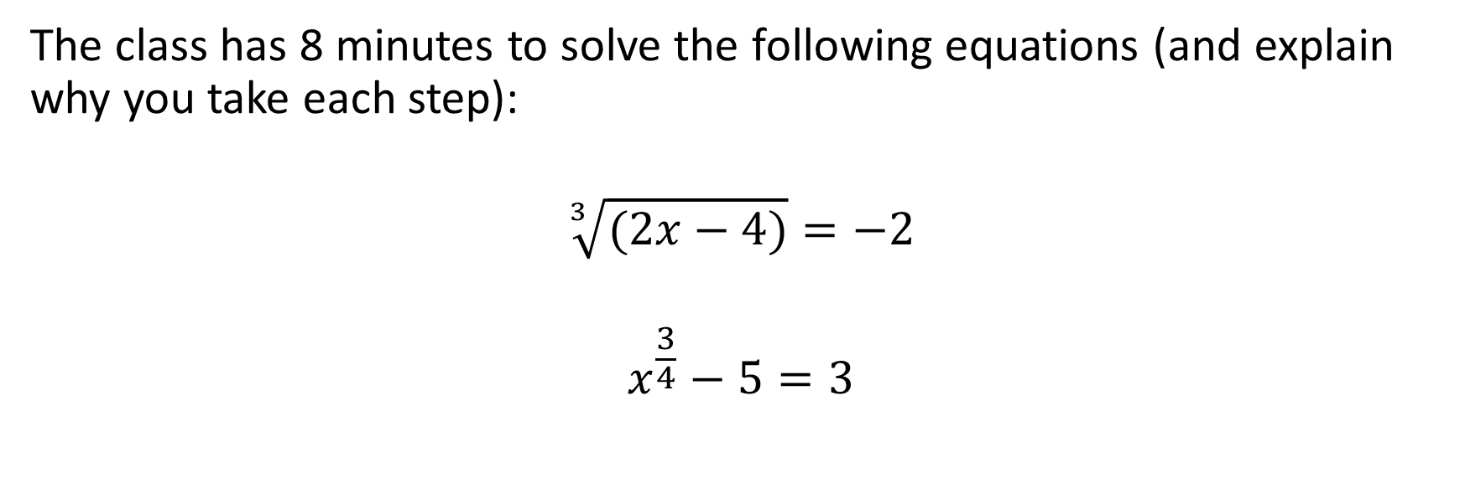
Step 7: Task 3
The class has 8 minutes to solve the following equations (and explain why you take each step):
$$\sqrt[3]{(2x−4)}=−2$$
$$x^{\frac{3}{4}}−5=3$$
Click to the next slide as soon as the group understands the task.

Slide 12
Step 8: Record
Type here if necessary.

Slide 13
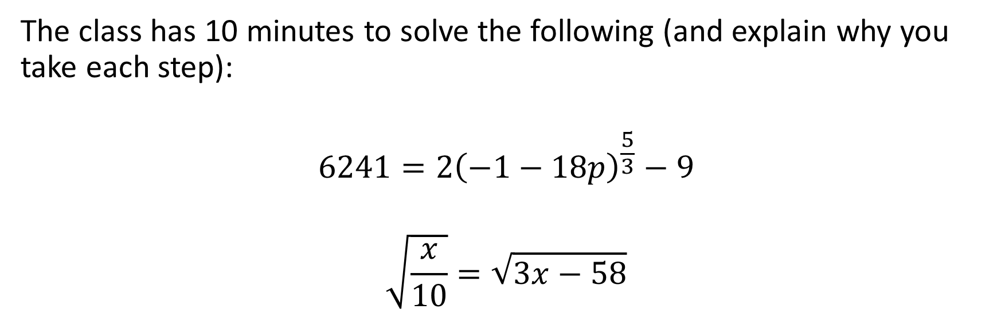
Step 9: Task 4
The class has 10 minutes to solve the following (and explain why you take each step):
$$6241=2{\left(−1−18p\right)}^{\frac{5}{3}}−9$$
$$\sqrt{\frac{x}{10}}=\sqrt{3x−58}$$
Click to the next slide as soon as the group understands the task.

Slide 14
Step 10: Record
Type here if necessary.

Slide 15
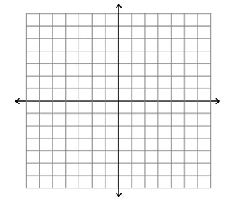
Step 11: Task 5
The class has 8 minutes to answer the following:
$y=\frac{1}{x+2}−3$
What is the parent function?
Transformations?
Asymptotes:_________
Domain:_________
Range:____________
End behavior:__________
Increasing interval:_________
Decreasing Interval:__________
Click to the next slide as soon as the group understands the task.

Slide 16
Step 12: Record
Type here if necessary.

Slide 17
Step 13: Task 6
The class has 8 minutes to answer the following:
$y=2\sqrt{x+8}−4$
What is the parent function?
Transformations?
Vertex:_________
Domain:_________
Range:____________
End behavior:__________
Increasing interval:_________
Decreasing Interval:__________
Click to the next slide as soon as the group understands the task.

Slide 18
Step 14: Record
Type here if necessary.

Slide 19
Step 15: Task 7
The class has 6 minutes to come up with and discuss the answer to the following question:
Solve:
$\frac{x−2}{3x−10}=\frac{1}{x−4}$
Click to the next slide as soon as the group understands the task.

Slide 20
Step 16: Record
Type here if necessary.

Slide 21
Step 17: Task 8
The class has 8 minutes to come up with and discuss the answer to the following question:
Solve the system:
$\frac{x}{y}=\frac{y}{x−8}$
$−2x+y=+5$
Click to the next slide as soon as the group understands the task.

Slide 22
Step 18: Record
Type here if necessary.

Slide 23
Step 19: Task 9
The class has 10 minutes to come up with and discuss the answer to the following question:
a varies jointly with y and the square of x and inversely with z. If a = 6 when x = 3, y = 2, and z = 12, find z when x = 2, y = 5, and a = 8.
Click to the next slide as soon as the group understands the task.

Slide 24
Step 20: Record
Type here if necessary.

