Slide 2
Let’s get started.
Click to the next slide ASAP!
Welcome to a Talking Day.

Slide 3
Step 1: Choose Roles
Role | Duties | Benefits
Mediator | Lead the discussion Call on participants Ask leading questions Talk to the teacher | Automatic 10/10
Timer | Keep track of time Keep participants on task | 2 Bonus Points
Recorder | Record group’s responses Submit group responses for grade Ask clarifying questions to the group | Automatic 10/10
Everyone Else | Talk Take notes Contribute to the group grade | Standard Grading (see next slide)
Board Recorder | Write down group responses on white board for all to see | Automatic 10/10
Click to the next slide as soon as roles are decided.

Slide 4
Step 2: Understand Grading
What to do…. | How you’re graded…
Talking | Each participant is responsible for contributing to the group’s objective(s). Each time a participant contributes to the group’s objective(s) in a *meaningful way, he or she will receive one point. Participants may receive up to 4 total talking points. Do not expect every time you talk to earn you a point.
Note Taking | Each participant is responsible for taking notes throughout the discussion. Notes will be handed in at the end of class. Participants receive two points for every half page of notes. Participants may receive up to 4 note points.
Group Grade | The group is responsible for finishing and submitting the teacher generated task(s) in the allotted time. The task will be graded out of 3 points. Each participant will receive the same grade on the task.
Click to the next slide as soon as everyone understand grading concepts.
Remember, the Mediator and the Recorder get an automatic 10/10 for their grade while the Timer gets two bonus points added to his or her grade.

Slide 5
Tomorrow’s Test Mediator should read this slide aloud. Move onto the next slide when done.
Want another reason to take good notes? You will be tested on this exact material tomorrow. These are very similar to the topics and problems on the test

Slide 6
Step 3: Task 1
The class has 5 minutes to come up with a GRAPHIC ORGANIZER with what this unit was about (no explanations). You need to have the overarching topic as well as specifics within. Organize as you see fit.
Click to the next slide as soon as the group understands the task.

Slide 7
Step 4: Record
Type here if necessary.

Slide 8
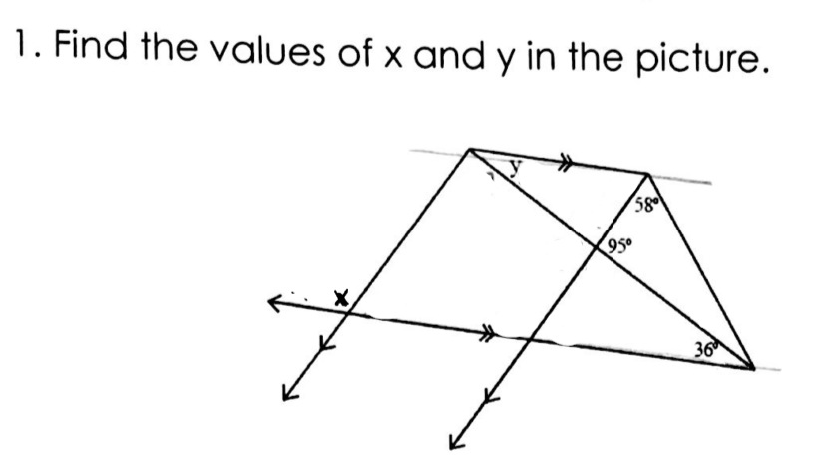
Step 5: Task 2,3,4
The class has 5 minutes to answer the following:
Click to the next slide as soon as the group understands the task.

Slide 9
Step 6: Record
Type here if necessary.

Slide 10
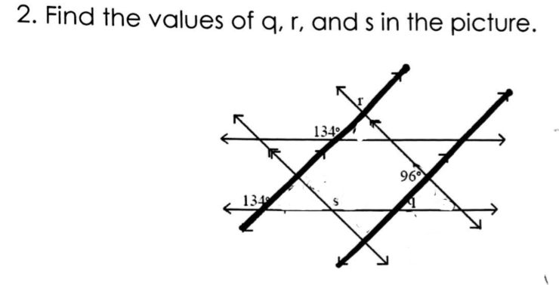
Step 7: Task 5
The class has 7 minutes to answer the following:
Click to the next slide as soon as the group understands the task.

Slide 11
Step 8: Record
Type here if necessary.

Slide 12
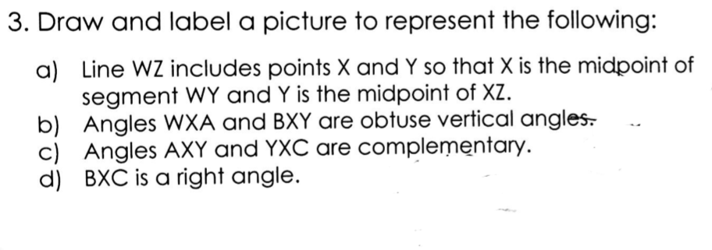
Step 9: Task 6
The class has 4 minutes to answer the following:
Click to the next slide as soon as the group understands the task.

Slide 13
Step 10: Record
Type here if necessary.

Slide 14
Step 11: Task 7
The class has 3 minutes to answer the following:
If the triangles are congruent give a reason and congruence statement.
Click to the next slide as soon as the group understands the task.

Slide 15
Step 12: Record
Type here if necessary.

Slide 16
Step 13: Task 8
Simplify
The class has 3 minutes to answer the following:
If the triangles are congruent give a reason and congruence statement.
Click to the next slide as soon as the group understands the task.

Slide 17
Step 14: Record
Type here if necessary.

Slide 18
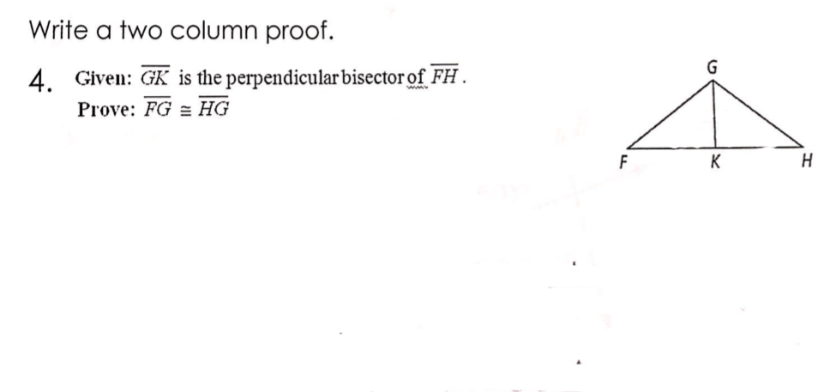
Step 15: Task 9
The class has 6 minutes to come up with and discuss the answer to the following question:
Click to the next slide as soon as the group understands the task.

Slide 19
Step 16: Record
Type here if necessary.

Slide 20
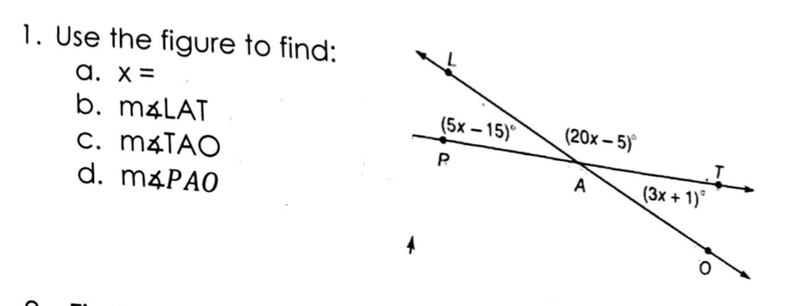
Step 17: Task 10
The class has 5 minutes to come up with and discuss the answer to the following question:
Click to the next slide as soon as the group understands the task.

Slide 21
Step 18: Record
Type here if necessary.

Slide 22
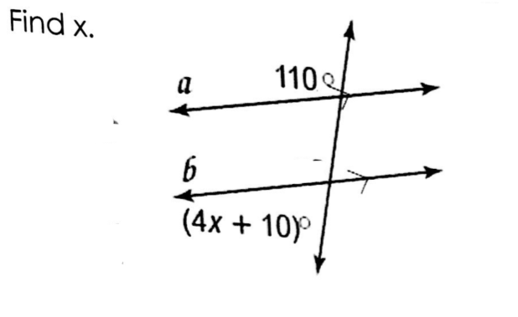
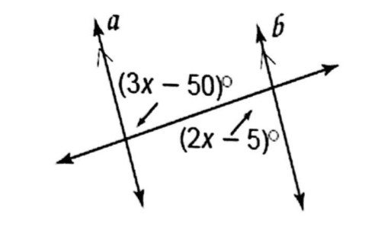
Step 19: Task 11
The class has 6 minutes to come up with and discuss the answer to the following question:
Click to the next slide as soon as the group understands the task.

Slide 23
Step 20: Record
Type here if necessary.

Slide 24
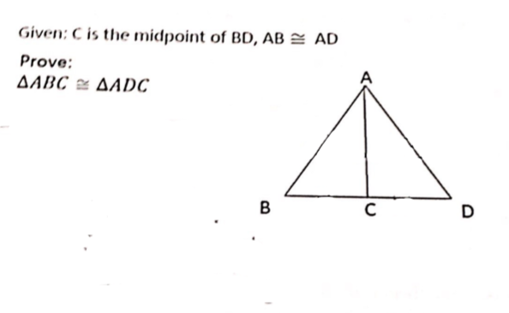
Step 21: Task 12
The class has 6 minutes to come up with and discuss the answer to the following question:
Click to the next slide as soon as the group understands the task.

Slide 25
Step 22: Record
Type here if necessary.

Slide 26
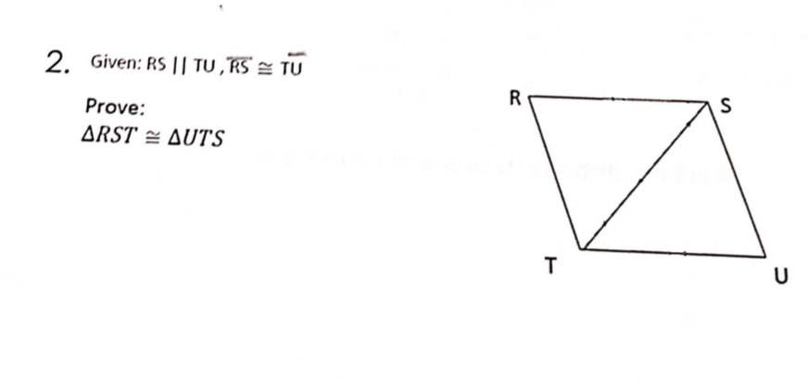
Step 23: Task 13
The class has 6 minutes to come up with and discuss the answer to the following question:
Click to the next slide as soon as the group understands the task.

Slide 27
Step 24: Record
Type here if necessary.

Slide 28
Step 25: Task 14
The class has 6 minutes to come up with and discuss the answer to the following question:
Click to the next slide as soon as the group understands the task.

Slide 29
Step 26: Record
Type here if necessary.

Slide 30
Step 27: Task 14
The class has 6 minutes to come up with and discuss the answer to the following question:
Click to the next slide as soon as the group understands the task.

Slide 31
Step 28: Record
Type here if necessary.

Slide 32
Step 29: Task 15
The class has 6 minutes to come up with and discuss the answer to the following question:
Click to the next slide as soon as the group understands the task.

