Slide 1
Warm up day 7

Slide 2
# of positive comments students make in a period
Student name | # comments
 | 9
 | 7
Travis | 4
Blake | 10
Adina | 6
Evelina | 5
Eva | 11
Gracie | 9
Nick | 8
Mohammed | 0
Find the following:
Mean 9. Range
Median 10. Outlier
Min 11. Mode
Max 12. Q1
Q3 13. IQR
Standard Deviation
Which is the best measure of center?
Which is the best measure of spread?

Slide 3
# of positive comments students make in a period
Student Name | # comments
Amanda | 9
Cole | 7
Tajiana’e | 4
Jack | 10
Aidan | 6
Tee | 5
Nejila | 11
Grace | 9
Nick | 8
Chris | 0
Find the following:
Mean 9. Range
Median 10. Outlier
Min 11. Mode
Max 12. Q1
Q3 13. IQR
Standard Deviation
Which is the best measure of center?
Which is the best measure of spread?

Slide 4
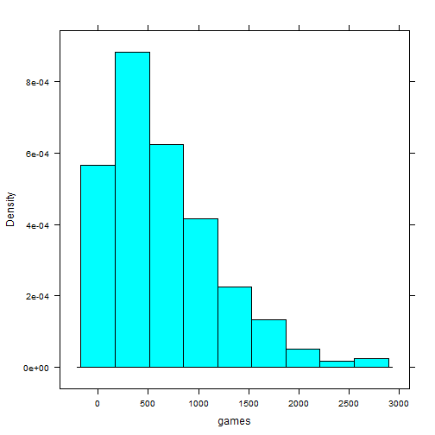
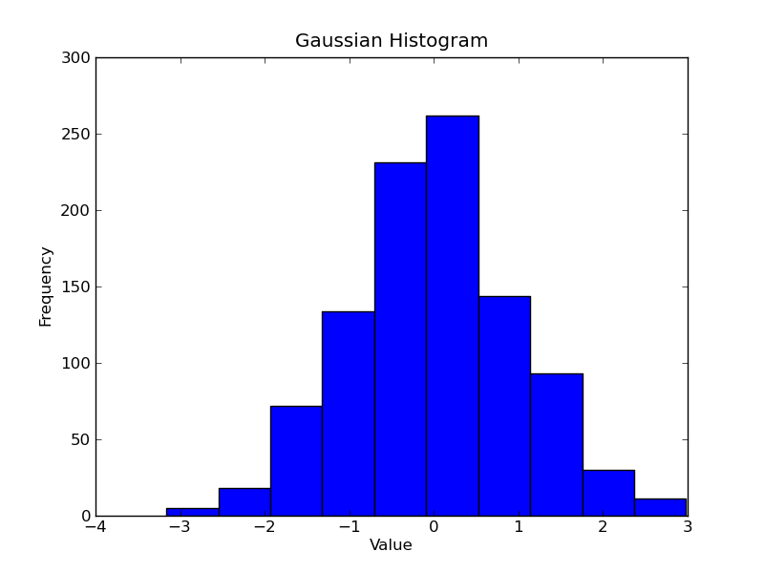
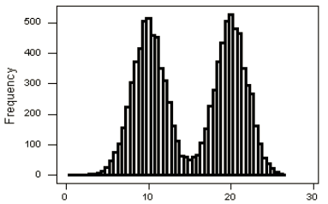
Name the Shape Center and Spread for each graph.

Slide 5
HW Answers for Set
1) Before 110
Mean – 63.18 Sx – 7.167 Min=60 Q1=60 Med=65
Q3=70 Max = 75 IQR=10
After 110
Mean – 67.083 Sx – 15.1445 Min=60 Q1=60 Med=65
Q3=70 Max = 10 IQR=10
Increase in mean and standard deviation but no change in median and IQR
2a) mean = 1530 Med=1380
2b) Outliers are $120 and $3500; mean is not as affected because there is a low and high outlier

Slide 6
HW Answers for Go
1) X-intercepts: (-2, 0) and (-5, 0)
Y-Intercept: (0,10)
Minimum: -2.25 (looking at the y-value of vertex)
2a) Brett: 103.5 feet
Andre: 75 feet
Brett is correct
2b) Brett: about 5 seconds
Andre: about 4.25 seconds

Slide 7
How do you find ‘r’ value
x | y
2 | 12
4 | 13
7 | 15
9 | 17
11 | 19
15 | 22
18 | 25
Turn Diagnostic On:
2nd Catalog
Scroll down to “Diagnostic On”
Press “Enter” twice
How to find “r” (correlation coefficient):
After you have put x into L1 and y into L2
Stat
Calc
LinReg(ax + b)
Enter

